Slide 1
Post Poll Scrutiny

Slide 2
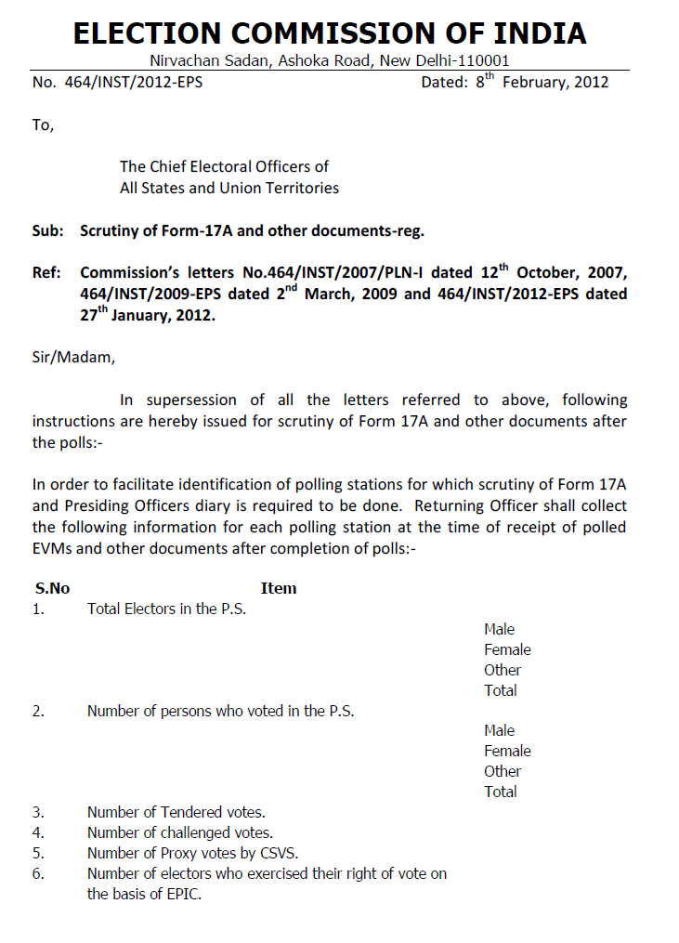

Slide 5
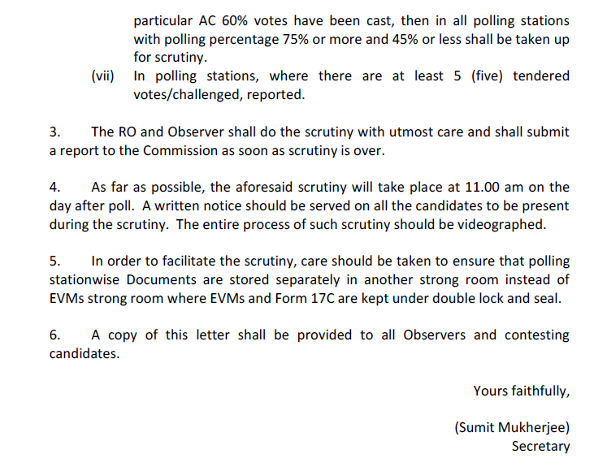

Slide 6
STATUTORY MATTERS
Voting by Blind and infirm Voters-instructions (ECI instruction No. 4/MISC/ECI/LET/FUNC/JUD/SDR Dated: 23rd October, 2017)
While Scrutinizing of various documents such as the Form 17A, Presiding Officers Diaries etc., by the Observer and Returning Officer on the day following the day of poll, Form 14 A shall also be scrutinized to see whether there are unusually larger no. of cases of companions accompanying the electors in recording votes in any Polling Station, which may create suspicion about the fairness of poll.

Slide 7
ADOPTED METHOD
To do this exercise, a suggestive format in excel has been devised.
A compilation of all unsealed forms is made in the form of a SPECIAL BOOKLET
At RC, during the compilation of data, that special booklet is used to fill up that excel format

Slide 8
The relevant criteria will be reflected in a single form and the polling stations which will come under the zone of scrutiny will easily be identified.
A-05 & P-05 WILL ALSO BE PREPARED AUTOMATICALLY FROM THAT EXCEL SHEET
A proceeding shall also be prepared during the scrutiny.

Slide 9
Model Proceeding for Post Poll Scrutiny
Proceedings of post poll scrutiny of Form-17A and other documents in c/w Parliament General Election,
In pursuance of No. 464/INST/2012-EPS dt. 08-02-2012 of the Election Commission of India, the scrutiny of Form-17A, Presiding Officers diaries and other related documents have been taken up today i.e. on ……………., at 11-00 AM at the …………………………………………………………….., in presence of Hon’ble Observer and the Returning Officer, ……………………………….. Parliamentary Constituency.
During scrutiny candidate / agent / authorized person of the following candidates were present.
And that upon thoroughly scrutinizing the Form-17A, Presiding Officers diaries and other related documents as came under the purview of 7 points category, of the guideline mentioned above, anomalies found in the following polling stations as noted below.
Hon’ble Observer Returning Officer
Sl. No. | No. & name of PC | No. & name of AC | No & name of Polling Stations taken up for scrutiny | Recommendation as to poll or fresh poll
Sl. No. | Name of the contesting candidate | Party affiliation | Whether candidate / agent / authorized person present on not
1
2
3
4
5
6
7
8
9

Slide 10
Reporting Formats on Post Poll Scrutiny

Slide 13
Thanks

